Slide 1
HTTP Connection
Mobile App Programming

Slide 2
What we learn today?
Let’s learn the Android Network Connection.
HTTP Networking in Android
HTTP using “okhttp”
Parsing JSON Using GSON
edu.skku.MAP.week8
Create project which contains empty Activity

Slide 3
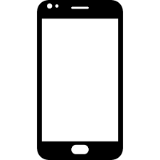
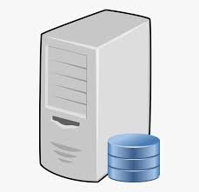

HTTP – Hypertext Transfer Protocol
What is HTTP?
HTTP is an application communication protocol for web service.
Client usually send HTTP request with JSON format and server will send response.
There are many HTTP methods(such as GET, POST, PUT, DELETE…), but we will treat only 2 methods, GET and POST.
HTTP request
HTTP response
Client
Server

Slide 4
HTTP – GET and POST
We will learn two HTTP methods, GET and POST
GET is used to request data form a specified resource.
Ex) Get student’s name whose id is “2020711485”.
Using GET method, you can get data from server.
POST is used to send data to a server to create/update a resource.
Ex) Add new user information in server database.
Using POST method, you can makes server perform what you have ordered.
You can send data using body with json data.

Slide 5
Let’s send HTTP request in android
There is a developer page for HTTP communication, named HTTPUrlConnection.
But it is annoying…(because mainActivity cannot use network, all network communication should use thread or AsyncTask) , therefore, we will use simple open source api named okhttp3
https://square.github.io/okhttp/
There is no server application, we will use reqres website as server.
https://reqres.in/
The most important thing is that You can’t use HTTP network in MainThread.

Slide 6
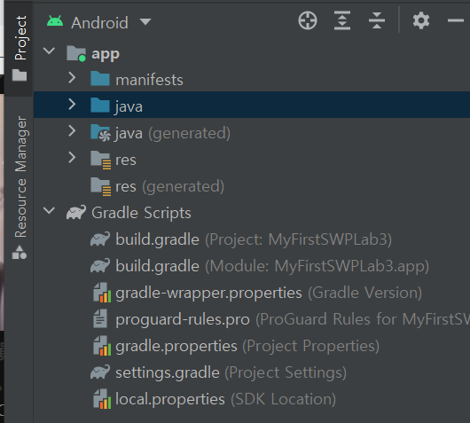
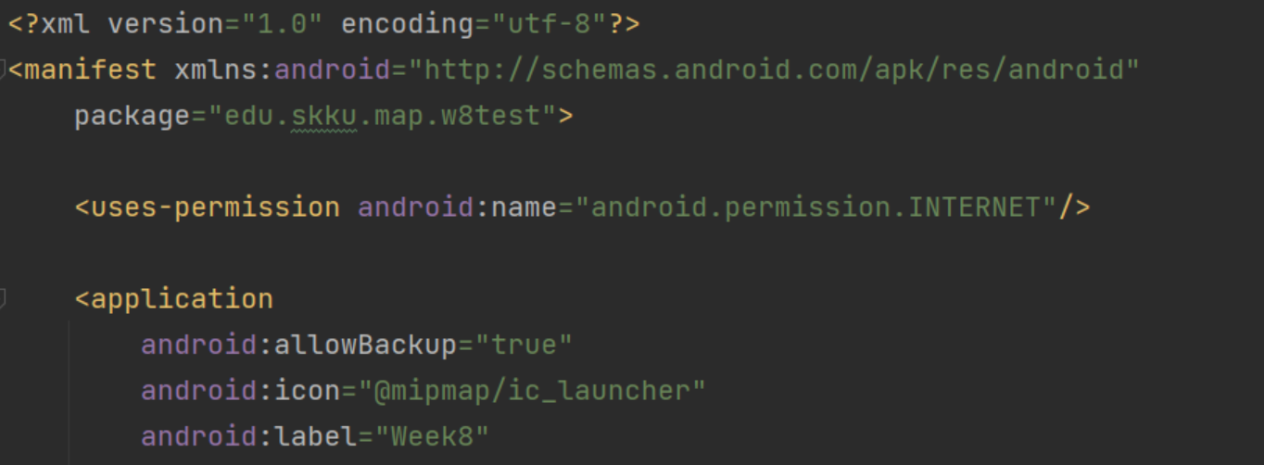
Before using okHTTP
You should add implementation in your build.gradle(Module) dependencies and syncNow.
And to use internet in your application add user-permission in your manifest file.

Slide 7
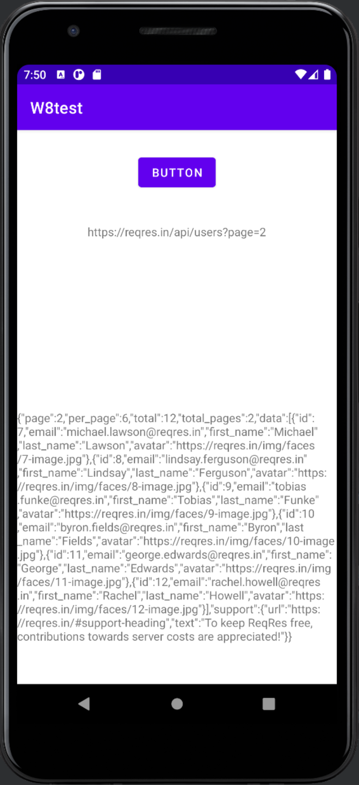
Example 1. send GET request
public class MainActivity extends AppCompatActivity { Button button; TextView textView1, textView2; @Override protected void onCreate(Bundle savedInstanceState) { super.onCreate(savedInstanceState); setContentView(R.layout.activity_main); textView1 = findViewById(R.id.textView1); textView2 = findViewById(R.id.textView2); button = findViewById(R.id.button); button.setOnClickListener(view -> { OkHttpClient client = new OkHttpClient(); HttpUrl.Builder urlBuilder = HttpUrl.parse("https://reqres.in/api/users").newBuilder(); urlBuilder.addQueryParameter("page","2"); String url = urlBuilder.build().toString(); textView1.setText(url); Request req = new Request.Builder().url(url).build(); client.newCall(req).enqueue(new Callback() { @Override public void onFailure(@NonNull Call call, @NonNull IOException e) { e.printStackTrace(); } @Override public void onResponse(@NonNull Call call, @NonNull Response response) throws IOException { final String myResponse = response.body().string(); MainActivity.this.runOnUiThread(new Runnable() { @Override public void run() { textView2.setText(myResponse); } }); } }); }); } }

Slide 8
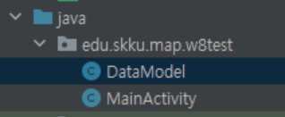
Parsing with GSON
As a response of request, You will get data with json format.
Therefore, you should parse it with GSON API.
https://github.com/google/gson
Add below dependency in build.gradle
And Let’s make data’s class which json will be converted to.
Add parameter with getter and setter.

Slide 9
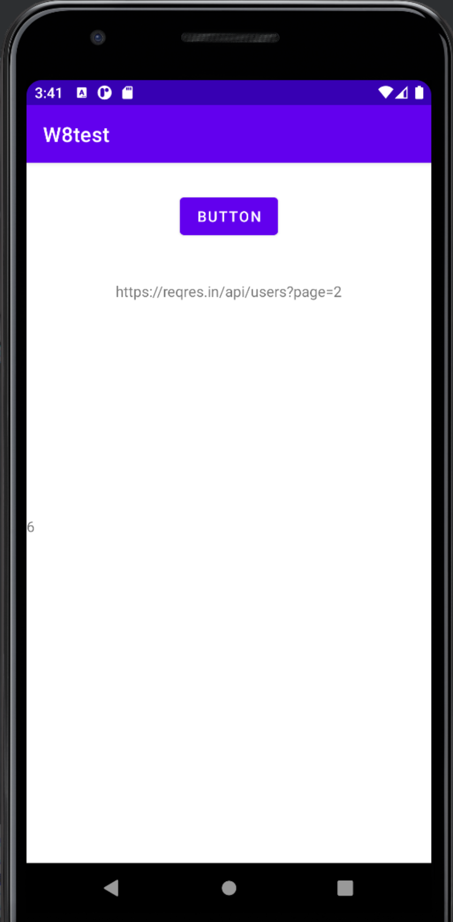
Example 2. GSON for parsing
Just add below code to Example 1
package com.example.week8; public class DataModel{
private String name; private String job; private String page; private String per_page;
… getter and setter … }
Gson gson = new GsonBuilder().create(); final DataModel data1 = gson.fromJson(myResponse, DataModel.class); MainActivity.this.runOnUiThread(new Runnable() { @Override public void run() { textView2.setText(data1.getPer_Page()); } });

Slide 10
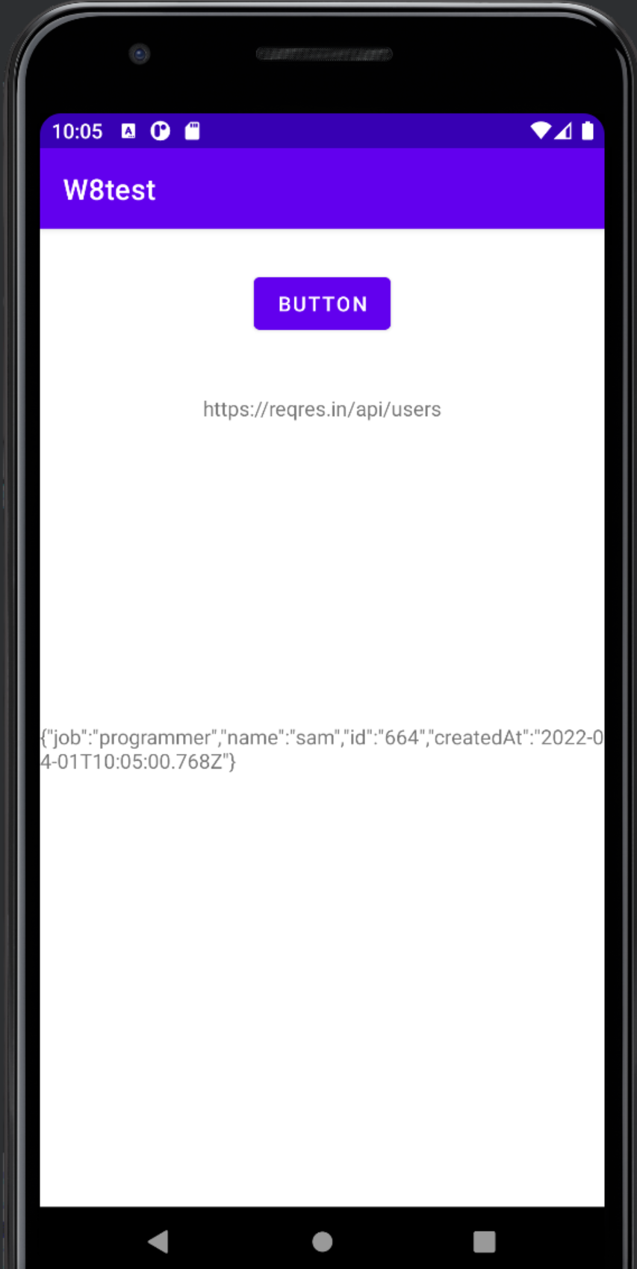
Example 3. Send POST request
public class MainActivity extends AppCompatActivity { Button button; TextView textView1, textView2; @Override protected void onCreate(Bundle savedInstanceState) { super.onCreate(savedInstanceState); setContentView(R.layout.activity_main); textView1 = findViewById(R.id.textView1); textView2 = findViewById(R.id.textView2); button = findViewById(R.id.button); button.setOnClickListener(view -> { OkHttpClient client = new OkHttpClient(); DataModel data = new DataModel(); data.setName("sam"); data.setJob("programmer"); Gson gson = new Gson(); String json = gson.toJson(data, DataModel.class); HttpUrl.Builder urlBuilder = HttpUrl.parse("https://reqres.in/api/users").newBuilder(); String url = urlBuilder.build().toString(); textView1.setText(url); Request req = new Request.Builder() .url(url) .post(RequestBody.create(MediaType.parse("application/json"),json)) .build();

Slide 11
Example 3. Send POST request
client.newCall(req).enqueue(new Callback() { @Override public void onFailure(@NonNull Call call, @NonNull IOException e) { e.printStackTrace(); } @Override public void onResponse(@NonNull Call call , @NonNull Response response) throws IOException { final String myResponse = response.body().string(); Gson gson = new GsonBuilder().create(); MainActivity.this.runOnUiThread(new Runnable() { @Override public void run() { textView2.setText(myResponse); } }); } }); }); } }

Slide 12

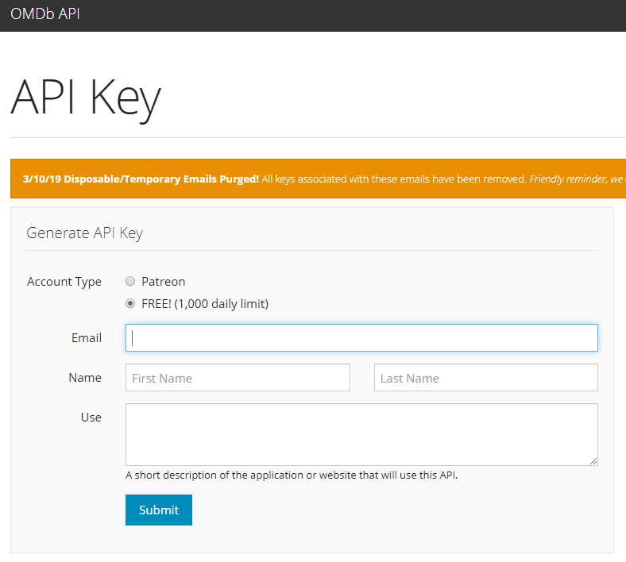
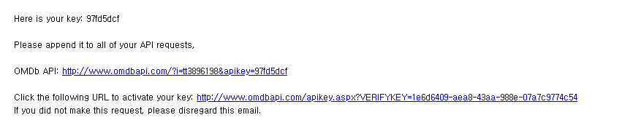
Lab practice – Make movie search application
This week we will make movie searching application using omdb API.
http://www.omdbapi.com/
Please get API key by entering your email.
And check your email to activate your key.
You should below line in your manifest file’s <application> tag

Slide 13
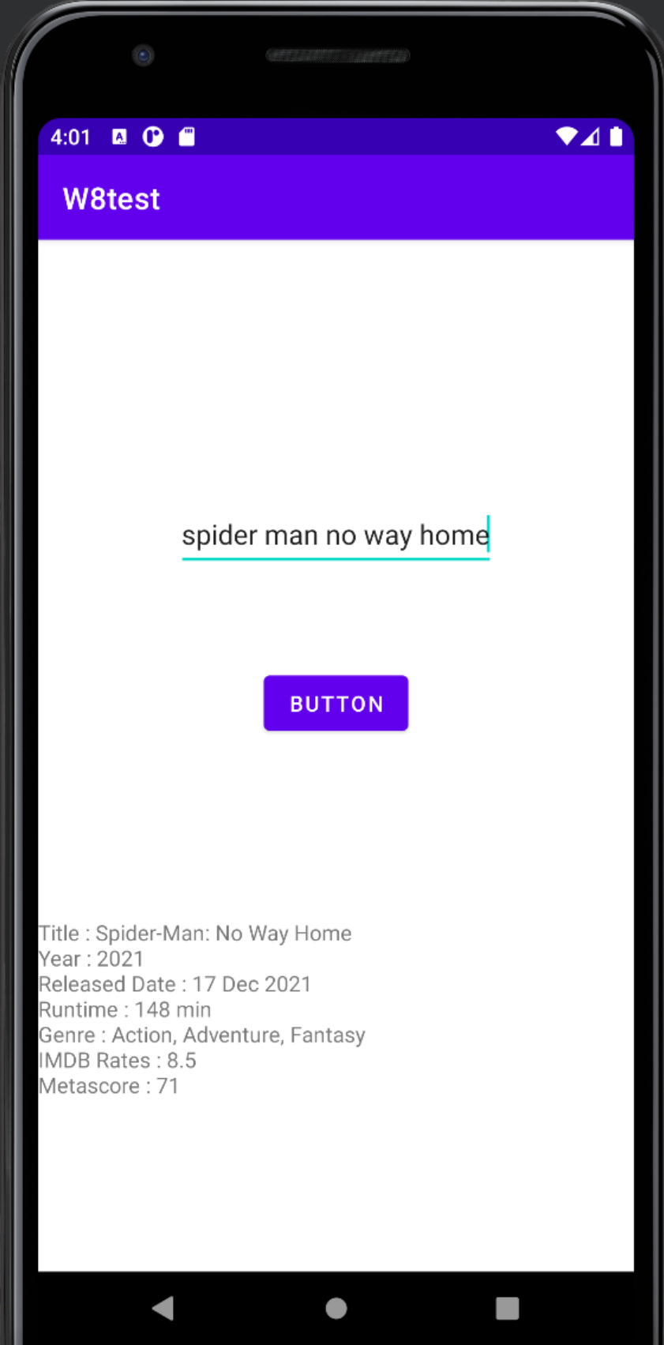
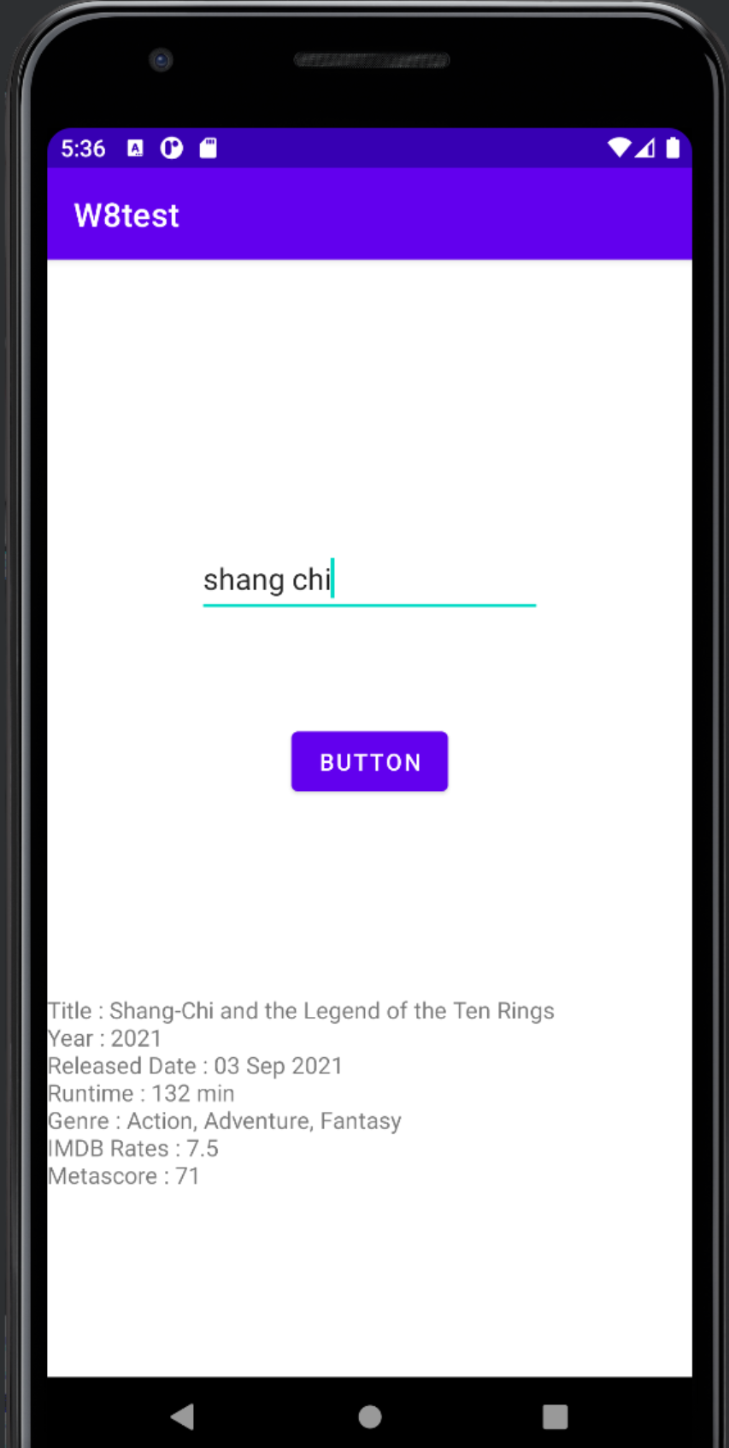
Lab practice – Make movie search application
Using GET method and add 2 query parameters, “t” and “apikey”.
“t” is title of movie, and “apikey” is key value you received from email.
Print title, year, released date, runtime, director, genre, IMDB rating, Metascore of input movie.
Submit your application on ICAMPUS
File->Export->Export to zip…
Change your zip to <StudentID_w8>.zip

